Slide 1

PANIMALAR ENGINEERING COLLEGE
Department of Mechanical Engineering
DESIGN AND FABRICATION
PROJECT ON
PORTABLE BENCH GRINDING MACHINE
Submitted by:
S.V.Ragul (211420114084)
S.Munishwaran (211420114070)
E.Raghul (211420114082)
V.Motheesh (211420114068)
Under the Guidance of:
J.Srinivas ME.,(PhD)
Assistant Professor
Department Of Mechanical Engineering

Slide 2
PANIMALAR ENGINEERING COLLEGE
Department of Mechanical Engineering
Introduction:
The grinding machine is used in a variety of sectors to finish work items and provide high-quality surfaces.
Grinding is a machining technique that involves the use of an abrasive wheel like cutting tool.
In most sectors, grinding is the last step in the manufacturing process. A bench grinder is an appliance that is used to sharpen other tools.
Bench grinder has wheels that you can use for grinding, sharpening tools, or shaping some objects.
Depending on the types and shape of the wheel, the use of a bench grinder can vary.

Slide 3
PANIMALAR ENGINEERING COLLEGE
Department of Mechanical Engineering
Abstract:
This Project focuses on current advancements made possible by the use of Regulator to vary the speed of the motor to reduce the power consumptions and to avoid the vibrations created while machining some workpieces.
This project helps to make the bench grinder a mobile machine where
It can be transported or moved easily from one place to another.
Unlike the traditional bench grinders our project focuses on the reduction of the weight of the machine.

Slide 4
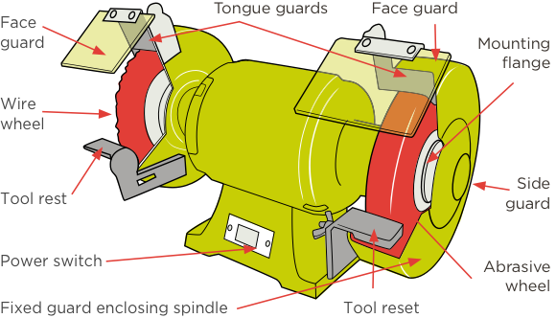
PANIMALAR ENGINEERING COLLEGE
Department of Mechanical Engineering
Parts of Bench Grinding Machine:

Slide 5
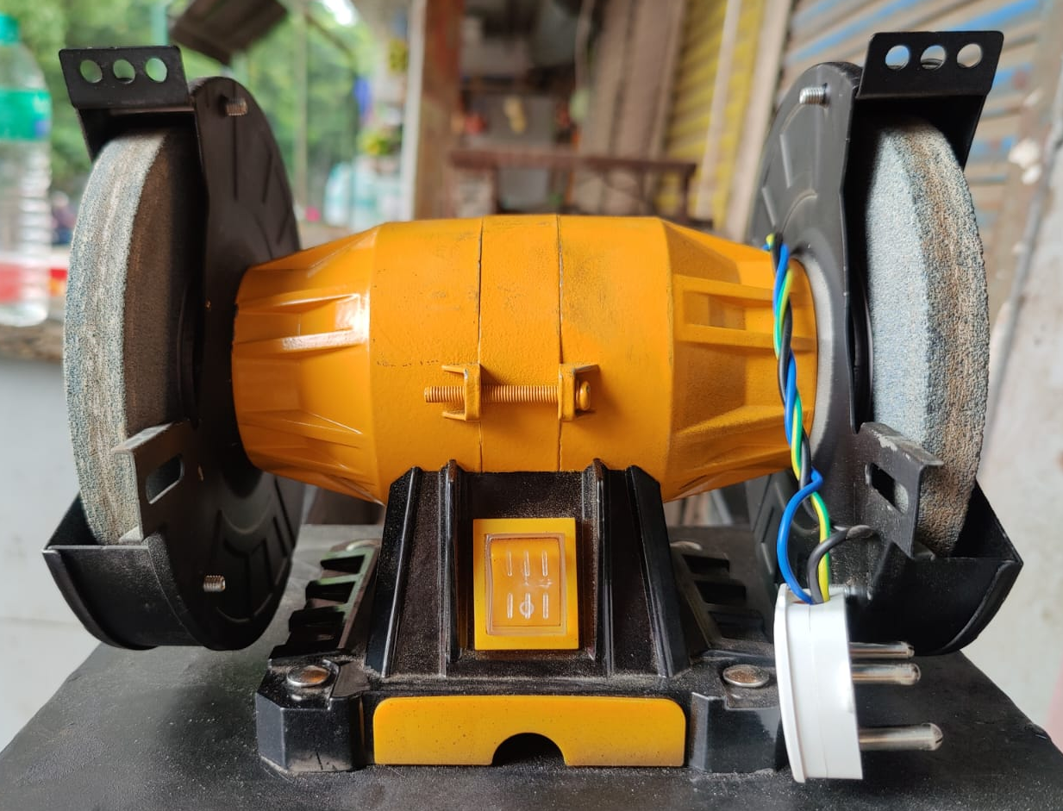
PANIMALAR ENGINEERING COLLEGE
Department of Mechanical Engineering
Parts and Specifications of Bench Grinding Machine:
Motor:
An electric motor is an electrical machine that converts electrical energy into mechanical energy.
Power: 150W
Current: 2AMP
Speed: 2950RPM
Volts: 220-240 AC

Slide 6
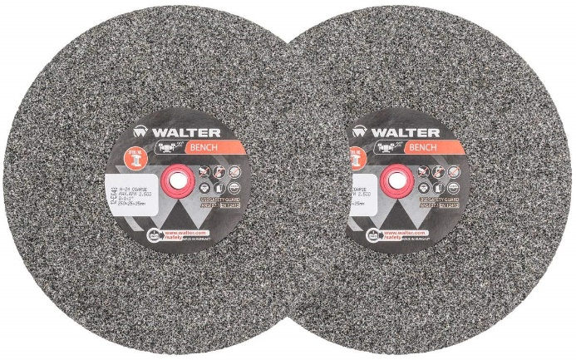
PANIMALAR ENGINEERING COLLEGE
Department of Mechanical Engineering
Grinding Wheels:
a wheel used for cutting, grinding, or finishing metal or other objects, and typically made of abrasive particles bonded together. Two types of grinding wheels are used in double wheeled bench grinders
Coarse grinding wheel:
Dimensions: 150 X 25 mm
Material: Silicon Carbide
Grit Size: 36/S
Diameter: 150mm

Slide 7

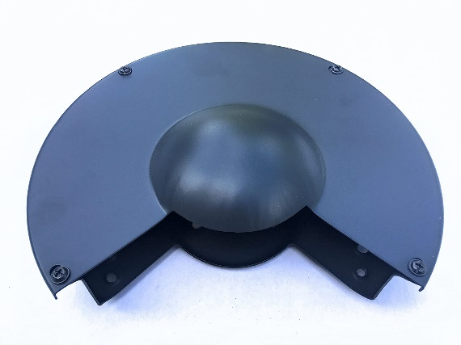
PANIMALAR ENGINEERING COLLEGE
Department of Mechanical Engineering
Fine grinding wheel:
Dimensions: 150 X 25mm
Material: Silicon Carbide
Grit Size: 60/S
Diameter: 150mm
Casing of Grinding Wheel:
Protective covering made in sheet metal is surrounded around the grinding wheel. The covering size varies according to the grinding wheel size.

Slide 8

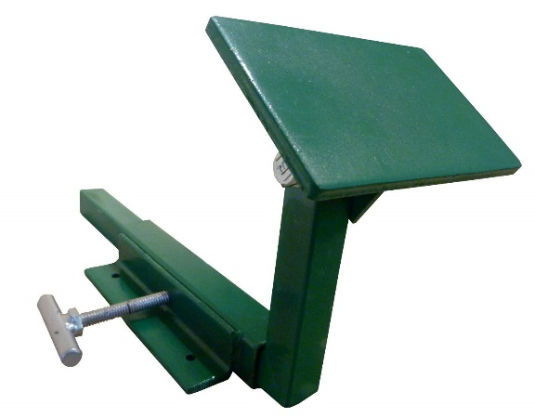
PANIMALAR ENGINEERING COLLEGE
Department of Mechanical Engineering
Eye Shield:
Eye Shield is a protective glass mounted on top of the bench grinder to prevent sparks from coming in contact with the workers face. Ecoline safety guard are used in this Bench grinder
Tool Rest:
he tool rest serves as a supporting surface when grinding cutting tools such as plane irons, bench chisels, and turning or carving gouges. A tool rest improves control, which results in a better grind.

Slide 9
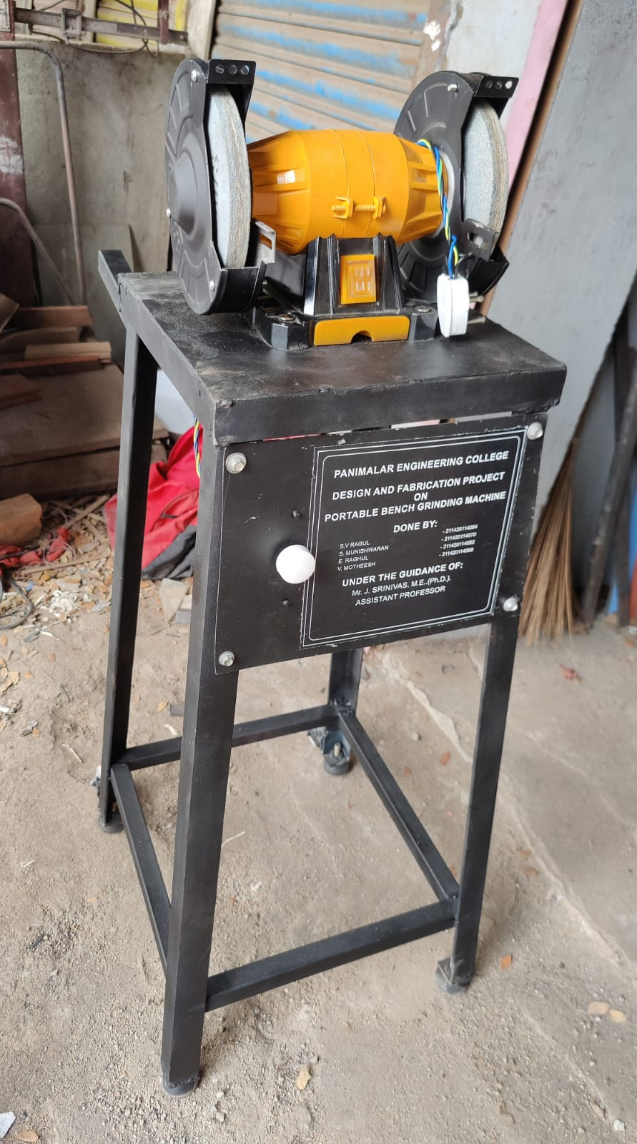
PANIMALAR ENGINEERING COLLEGE
Department of Mechanical Engineering
Supporting Base:
A supporting stand for bench grinder is vital to its performance. It helps in reducing the vibration by absorbing it. The weight of the stand should be more than the bench grinding machine.
Specifications:
Dimensions: 30.5 x 30.5 x 3.5 cm
Height dimension: 79 x 40.5 cm
Material: mild steel
Weight: 12 kg

Slide 10
PANIMALAR ENGINEERING COLLEGE
Department of Mechanical Engineering
Regulator Modifications:
Regulator controls are made to be added.
Regulator control helps in reducing the power consumptions by reducing the speed of the motor speed.
Some materials can be machined even with less rotational speed of the motor, there regulator can be useful to reduce the speed.
By adding regulators in a bench grinding machine we can increase its lifetime running hours by fluctuating the speed of the motor.
Type of Regulator Used:
“FLUSH DP 1500W CONTROLLER” Thyristor Electronic Regulator Dimming Speed Regulation.

Slide 11
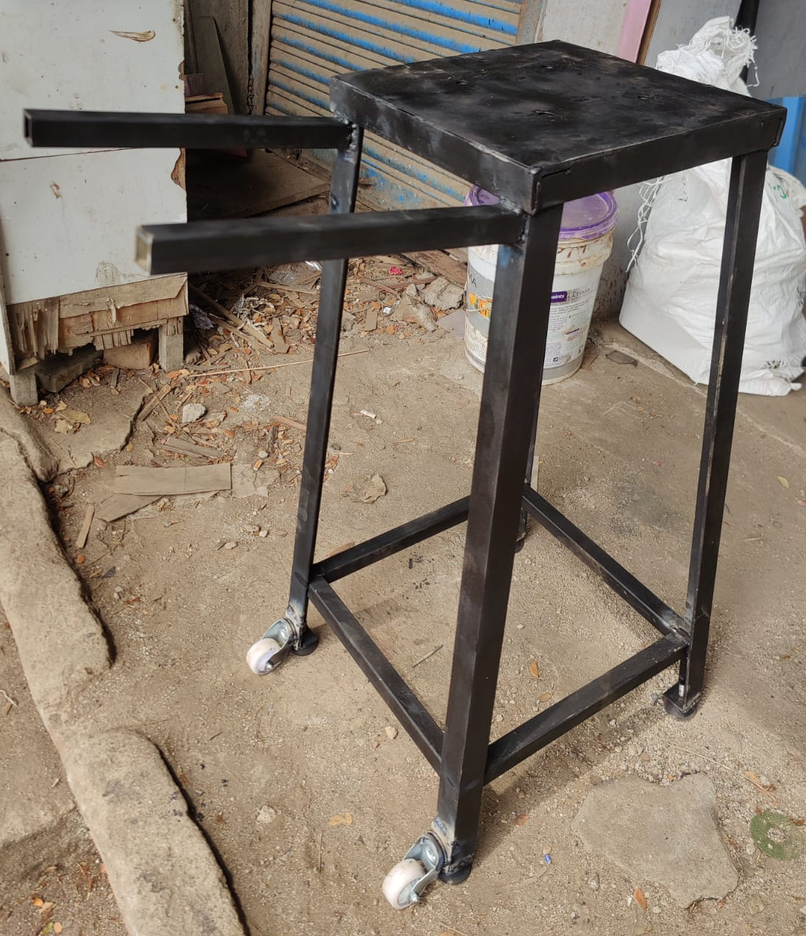
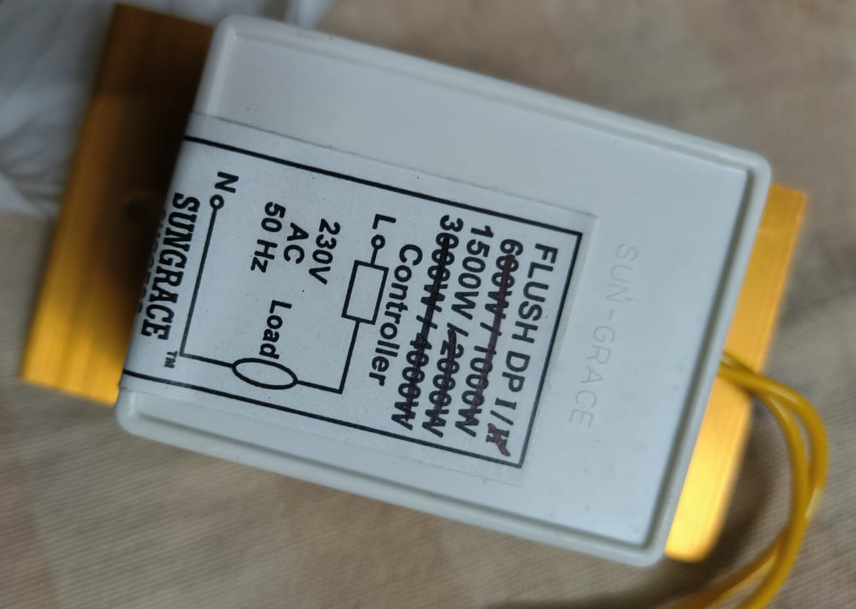
PANIMALAR ENGINEERING COLLEGE
Department of Mechanical Engineering
Regulator model:
Base Modifications:
We have attached two wheels at the end of the base above the
rubber bush for mobility.
We have attached handle bars at the back of the base for moving
the bench from one place to another.
The bench is tilted backwards and the attached wheel come in contact
with the ground and the bench can be easily moved from one place to another.

Slide 12
PANIMALAR ENGINEERING COLLEGE
Department of Mechanical Engineering
Conclusion:
By modifying the bench grinding machine, it can be useful with power
consumption and can be utilized for various purpose like polishing, buffering,
sharpening and shaping etc.
When compared to the traditional bench grinding machines, our machine
The ability to regulate the speed so it will be a great use while machining.
Unlike Traditional bench grinders, our bench grinding machine is mobile
and can be easily transported to any other locations.
When compared to traditional bench grinding machine our bench grinder is very
Compact and portable in nature.
Because of this innovation the need for taking the workpiece to the workshop
frequency is reduced.

Slide 13

PANIMALAR ENGINEERING COLLEGE
Department of Mechanical Engineering

